Slide 1
HTML 5

Slide 2
Lesson Objectives
After completing this module, you will be able to:
Understand the structure of an HTML table.
Controlling table format

Slide 3
Tables

Slide 4
Creating Tables
Table contains data in the format of rows and columns.
For an example, department information’s are displayed in the tabular format as shown below :-
The above “Department” table contains 4 rows and 2 columns.
Deptno | Dname | Location
10 | Accounting | New York
20 | Research | Dallas
30 | Sales | Chicago
40 | Operations | Boston

Slide 5
Creating Tables
An HTML table can be created using <table> elements
<table>
• Define an HTML table
• Other elements like <tr>, <caption>,.. can be nested inside <table> element
An HTML table has two kinds of cells
Header Cells
• <th>
‒ Defines a table header
Standard Cells
<tr>
• Defines a table row
• A row can have one or more <td> or <th> elements
<td>
Defines a table cell data
Employee Name | Salary
Ajay | 99322
Sandeep | 32000
Header Cells
Standard
Cells

Slide 6
Creating Tables
Syntax
<table>
<tr> <th>Column1 Header</th> <th>Column2
Header</th></tr>
<tr> <td>Cell 1,1</td> <td>Cell 1,2</td>
</tr>
<tr> <td>Cell 2,1</td> <td>Cell 2,2</td>
</tr>
</table>

Slide 7
Creating Tables
Some more elements which can be used while creating tables are:
<thead>
Group header content in an HTML table
<tbody>
Group the body content in an HTML table
<tfoot>
Group footer content in an HTML table
<caption>
Defines a caption for the table
<caption> element should follow with <table> element immediately.
<caption> element value will be center aligned and displayed above the table

Slide 8
Creating Tables
Syntax
Table column headings:
<table>
<caption>This is table caption</caption>
<tr>
<th>COLUMN 1</th>
<th>COLUMN 2</th>
<th>COLUMN 3</th>
</tr>
</table>

Slide 9
Creating Tables
Syntax
<table>
<thead>
<tr><td>.....</td></tr>
</thead>
<tfoot>
<tr><td>.....</td></tr>
</tfoot>
<tbody>
<tr><td>....</td></tr>
<tbody>
</table>

Slide 10
Blank Data Cell (Code)
Inserting Blank Data Cell :
<td></td>
<td><br></td>

Slide 11
Creating Tables
TableHeading.html

Slide 12
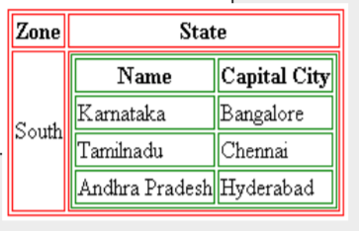
Nested Tables (Code)
A cell can contain another table within it.
<table>
<tr> <th>Zone</th> <th> State </th> </tr>
<tr> <td>South</td>
<td><table>
<tr> <th>Name</th> <th>Capital City</th> </tr>
<tr> <td>Karnataka</td> <td>Bangalore</td> </tr>
<tr> <td>Tamilnadu</td> <td>Chennai</td> </tr>
<tr> <td>Andhra Pradesh</td> <td>Hyderabad</td>
</tr>
</table></td></tr>
</table>

Slide 13
DEMO
tabnest4.htm

Slide 14
Table Formatting

Slide 15
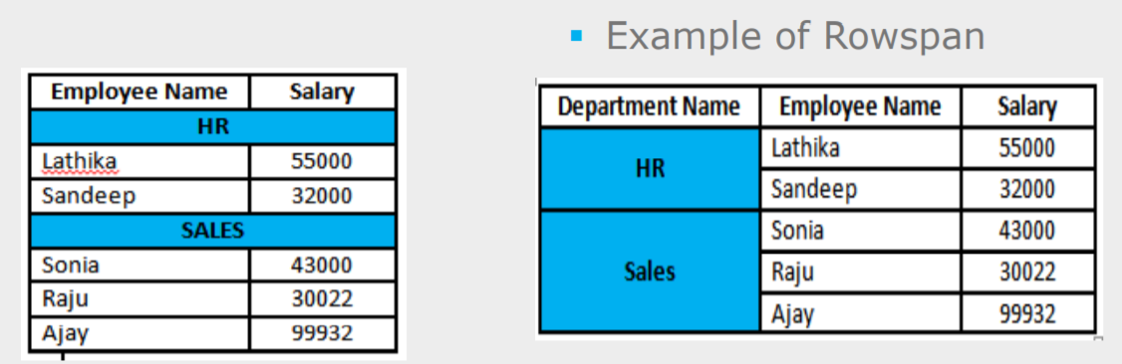
Table Formatting
Cell Spanning
Table cells can span across more than one column or row.
Types of cell spanning
• Row spanning
• Column spanning
Example of Colspan

Slide 16
Cell Spanning (Code)
Row spanning/Column spanning:
Use rowspan and colspan attribute either in <td> or <th> element.
<table>
<tr>
<th rowspan=m>Multiple Column
Header</th>
<th colspan=n>Multiple Row
Header</th>
</tr>
</table>
m & n are integers specifying number of rows and columns respectively

Slide 17
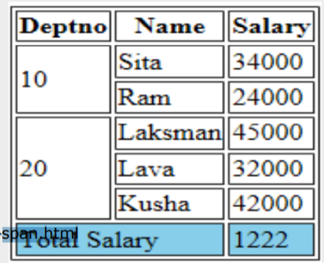
Cell Spanning Demo
Table-span.html

Slide 18
Grouping of Columns
<colgroup> tag specifies a group of one or more columns in a table for
formatting
The <col> tag specifies column properties for each column within a
<colgroup> element.
Use <colgroup> and <col> tags to group columns with common properties
like
Span attribute :
• Identifies number of columns in the current group.
• Default value is 1
• Provide span attribute and omit <col> tag
Example for grouping 3 columns and applying background color as green
<table>
<colgroup span=“3” style=“background-color:green”> </colgroup>
<col>
<col>
<tr>
table contents……
</tr>
</table>

Slide 19
DEMO
tabcol3.htm

Slide 20
Summary
After completing this module you know:
Structure of an HTML table
Control table format such as cell spanning
Use tables to format contents of an HTML Page.

